Slide 1

2020 Stack Overflow Developer Survey
Berk Büyükyıldız
Ahmet Erdem Sirel
Bengi Düzgel

Slide 2

What is our aim?
Predicting the annual compensation of professional developers based on stackoverflow annual developer survey.
Understranding factors related to compansation of a developer.

Slide 3


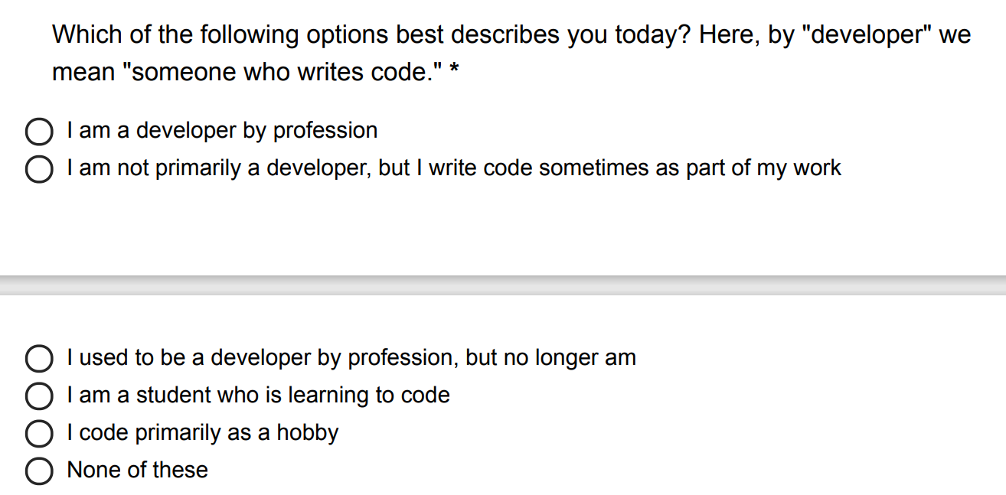
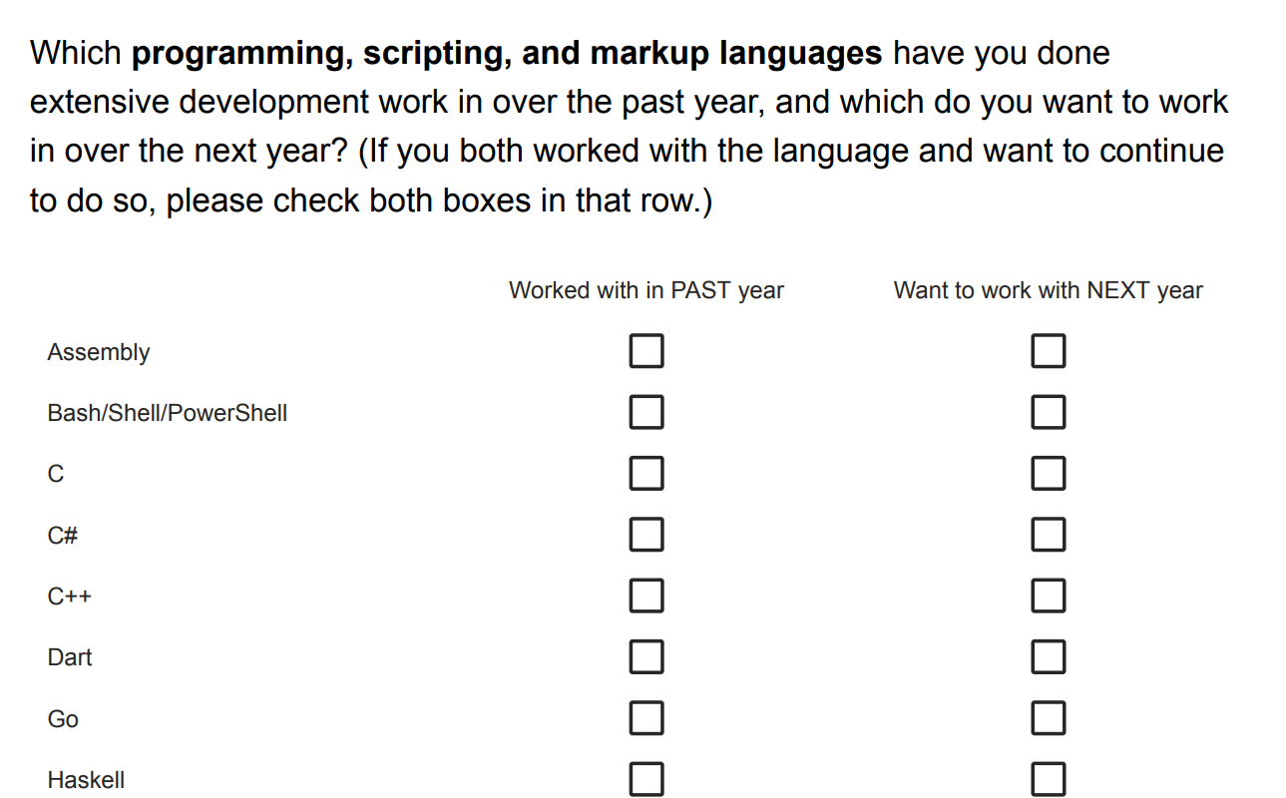
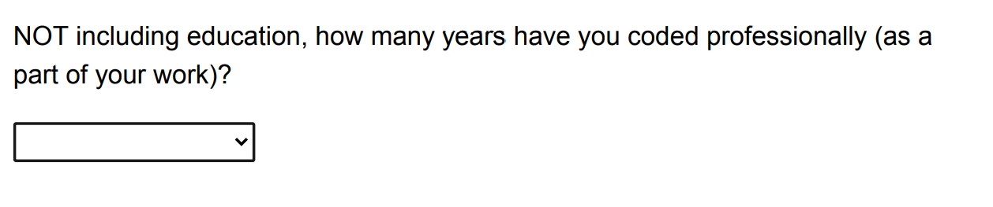
About the data
61 columns
64,461 rows
Categorical
Single Choice
Multiple Choice
5
Continues

Slide 4
Explanatory Analysis
Country
Age
Education Level
Technologies WorkedWith
DevType

Slide 5
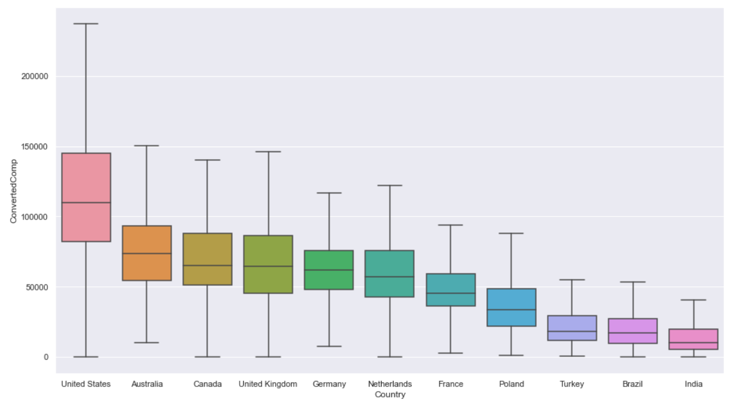
Professional Developer Compensations by Country
Median salary in United States is +50% than other countries

Slide 6
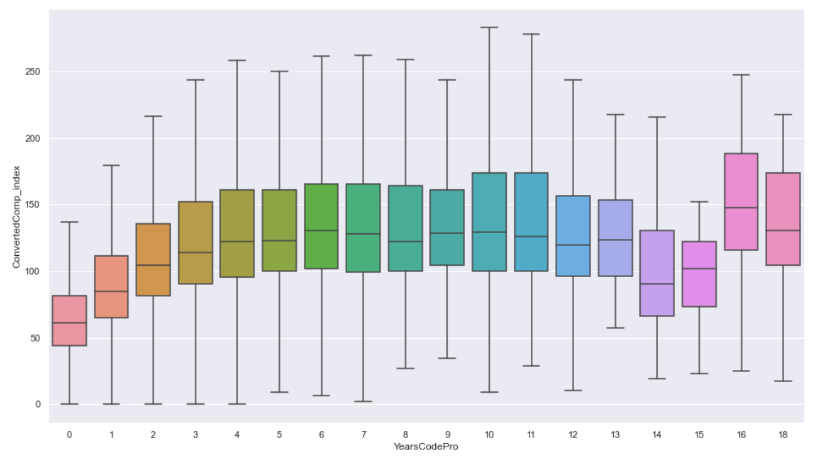
Professional Developer Compensations by YearsCodePro
Compensation increase reach its steady state after 12 years.
(3 years period)

Slide 7
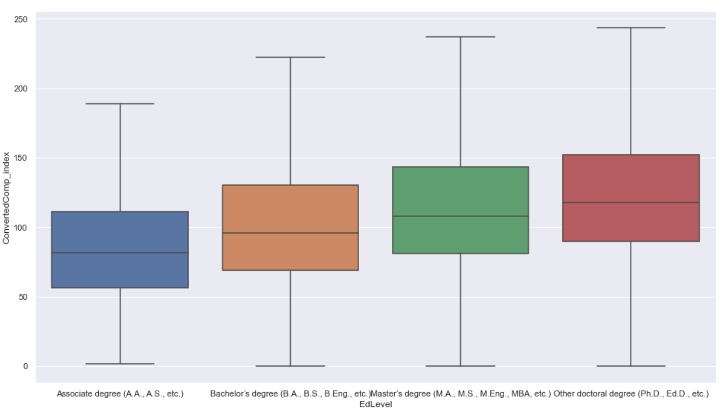
Professional Developer Compensations by Education Level
Education level increase is proportional to increase in compensation
10%
13%
17%

Slide 8
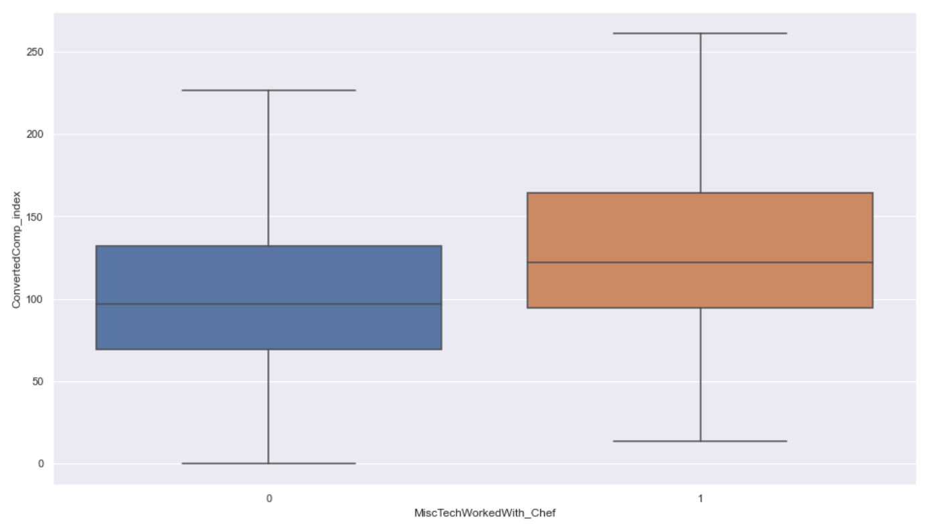
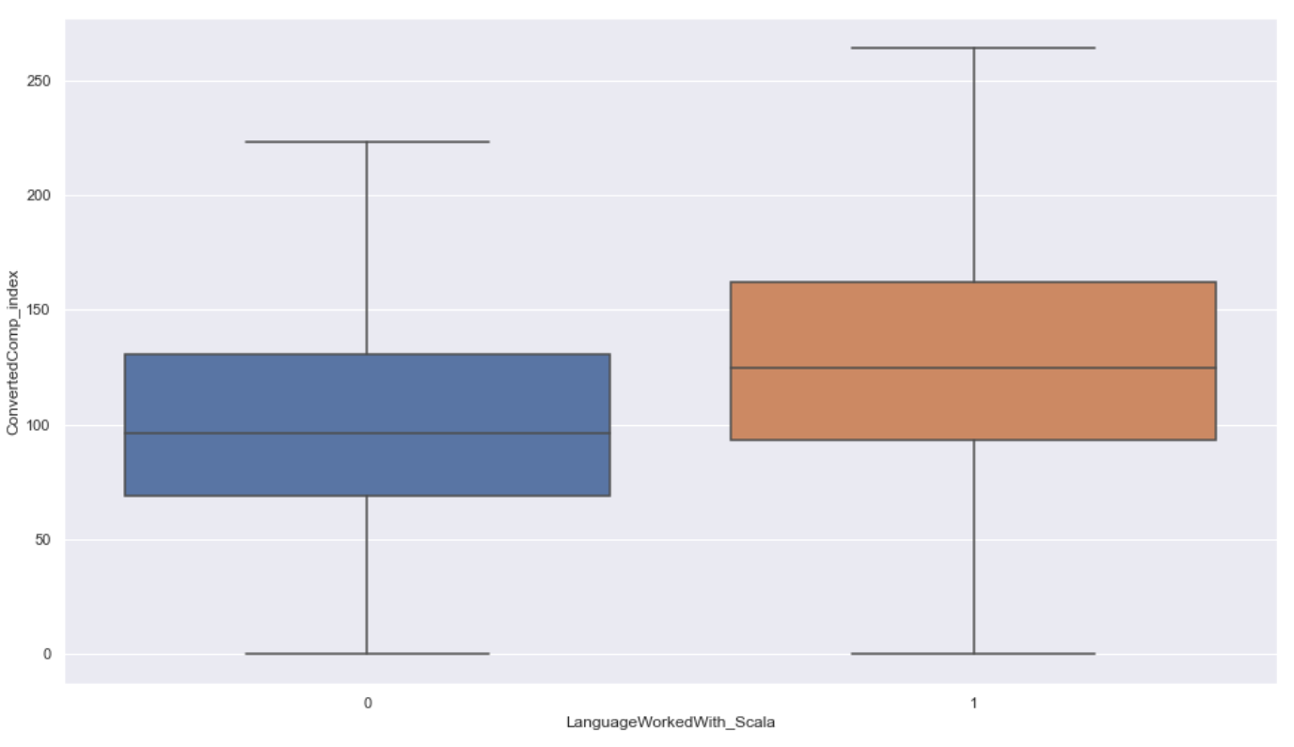
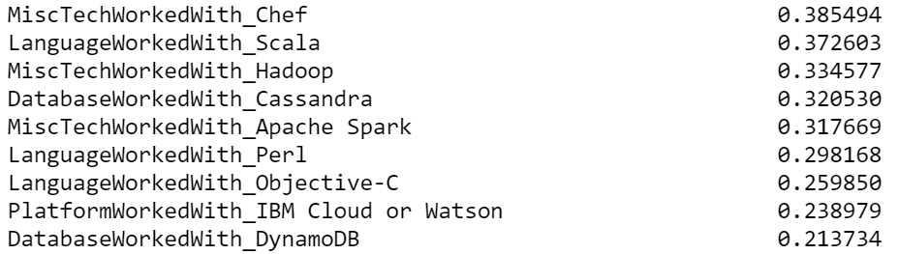
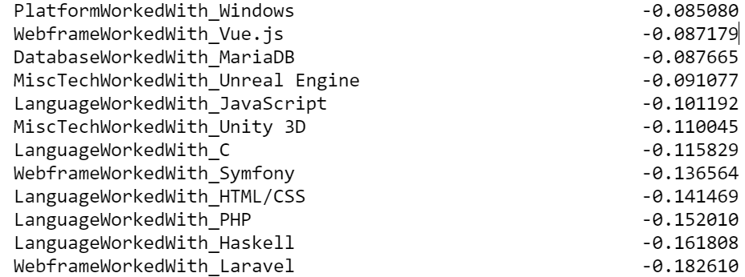
By technologies WorkedWith
High Leverage
Low Leverage
Chef
Scala

Slide 9
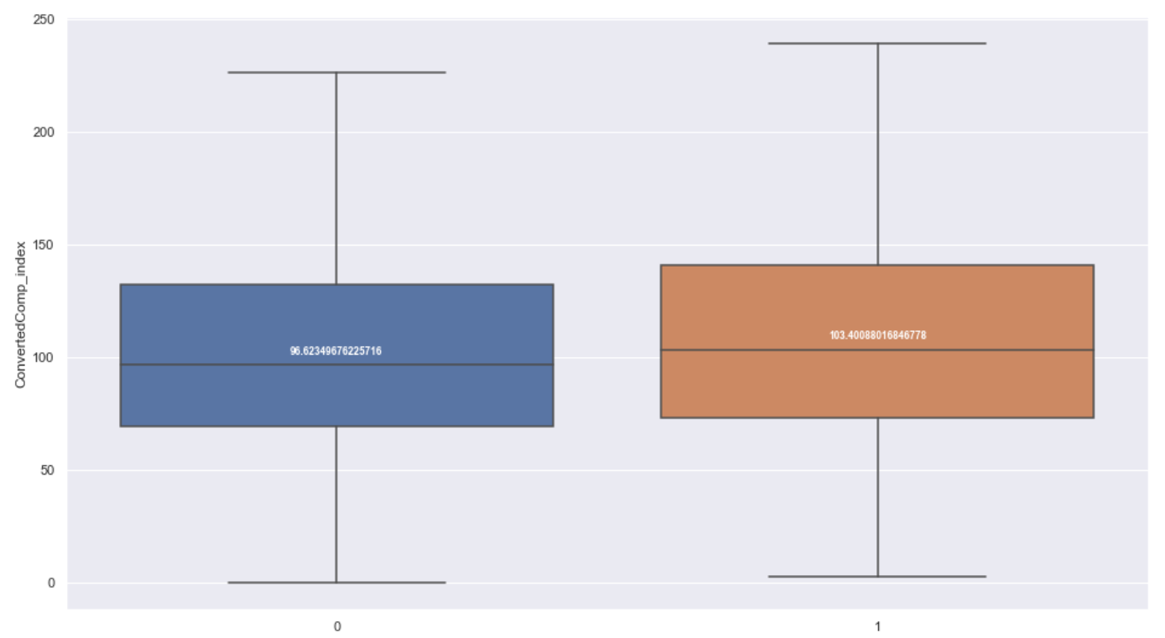

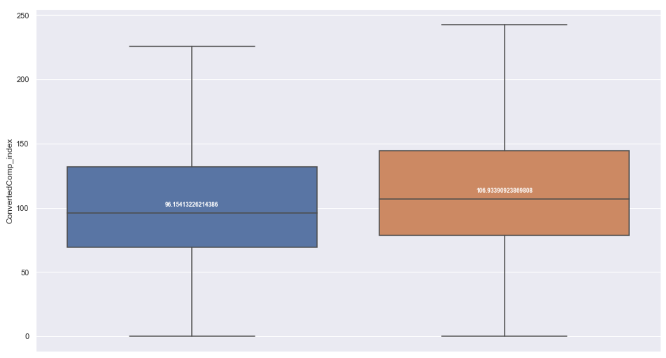

By DevType
Leverage: %7
Leverage: %6
Leverage: %11
Leverage: %16
Data Scientist / MLE
Backend Developer
Data Engineer
DevOps Engineer

Slide 10
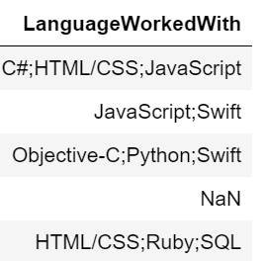
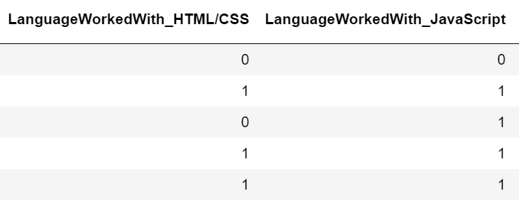
Data preparation
Out of scope
Processing multi-choice columns
Age > 90
Annual Compensation > $500.000
Annual Compensation < $100
Not professional developers
Countries that has less than 200 observation
No compensation information
Multi-choise columns processed with Apache Spark
For each selected item, a new column created with 1 otherwise 0.
Missing data handling
Processing categorical columns
Features with missing data filled with median value
Dummy variables are created for each categorical feature.
Outlier data handling
Precessed Data
Modeled Data
Raw Data
Age > 70: 70
YearsCodePro > 40: 40
Age1stCode > 30: 30
61 columns
64,461 rows
569 columns
21934 rows
403 columns
21934 rows
* Only in train set!

Slide 11
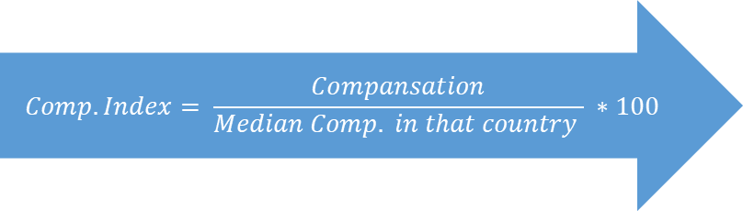
Target Transformation
Annual Comp.
Country A
Annual Comp. Index
50.000$
38.000$
27.000$
42.000$
24.000$
132
100
71
111
63
$$Comp. Index= \frac{Compansation}{Median Comp. in that country } ∗100$$
...
...
38.000$
Median
So, We can compare the factors affecting the compansation regardless of the country...

Slide 12
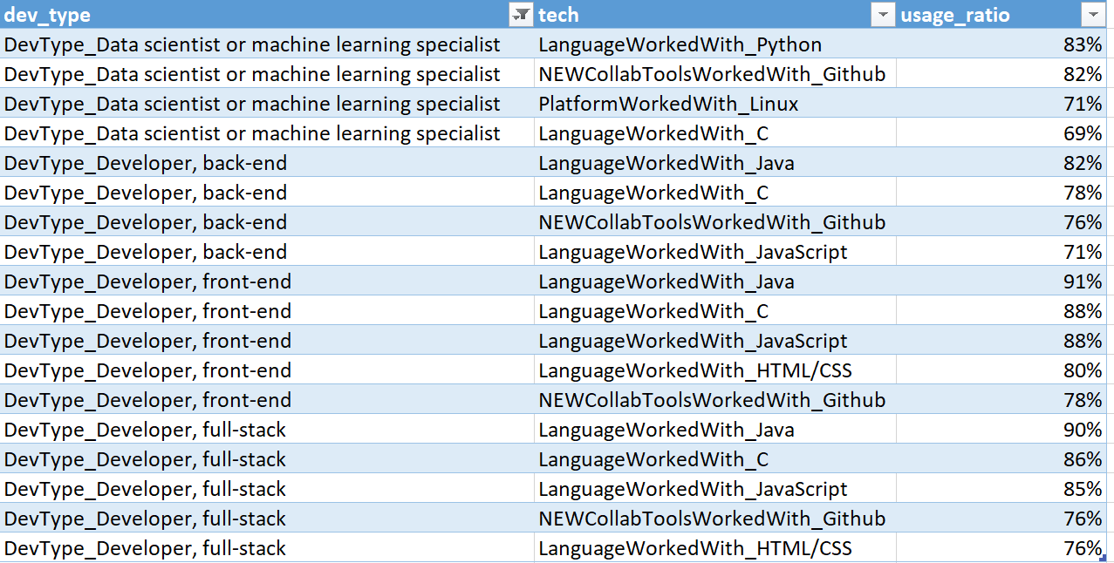
Aggregations: DevType - WorkedWith
Step1:
Commanly used technologies identified for each developer group has the.
Step2:
For each respondent, the rate of technologies used among commanly used technologies acording to dev type.
1
2
It’s been more than 30 years since
C programming language has been introduced but still widely used language in most of development roles
Version Control Systems can be considered standard way of collaboration in both enterprises and academia when Github’s usage ratio considered

Slide 13

Aggregations : High and Low Leverage Tech
High Leverage Tech
Low Leverage Tech
MiscTechWorkedWith_Chef
LanguageWorkedWith_Scala
MiscTechWorkedWith_Hadoop
DatabaseWorkedWith_Cassandra
MiscTechWorkedWith_Apache Spark
LanguageWorkedWith_Perl
LanguageWorkedWith_Objective-C
PlatformWorkedWith_IBM Cloud or Watson
DatabaseWorkedWith_DynamoDB
DatabaseWorkedWith_Couchbase
PlatformWorkedWith_AWS
PlatformWorkedWith_Kubernetes
NEWCollabToolsWorkedWith_Stack Overflow for Teams
LanguageWorkedWith_Go
LanguageWorkedWith_Dart
PlatformWorkedWith_MacOS
LanguageWorkedWith_Ruby
DatabaseWorkedWith_Redis
LanguageWorkedWith_Swift
LanguageWorkedWith_Julia
NEWCollabToolsWorkedWith_Jira
LanguageWorkedWith_C#
NEWCollabToolsWorkedWith_Gitlab
MiscTechWorkedWith_Cordova
DatabaseWorkedWith_MySQL
PlatformWorkedWith_WordPress
LanguageWorkedWith_SQL
PlatformWorkedWith_Arduino
LanguageWorkedWith_Java
WebframeWorkedWith_jQuery
PlatformWorkedWith_Windows
WebframeWorkedWith_Vue.js
DatabaseWorkedWith_MariaDB
MiscTechWorkedWith_Unreal Engine
LanguageWorkedWith_JavaScript
MiscTechWorkedWith_Unity 3D
LanguageWorkedWith_C
WebframeWorkedWith_Symfony
LanguageWorkedWith_HTML/CSS
LanguageWorkedWith_PHP
LanguageWorkedWith_Haskell
WebframeWorkedWith_Laravel
$$leveragetech= \frac{mean comp index users}{mean comp index not users} −1$$
* calculated in train set!
Feature
How many of the high leverage technologies are used?

Slide 14
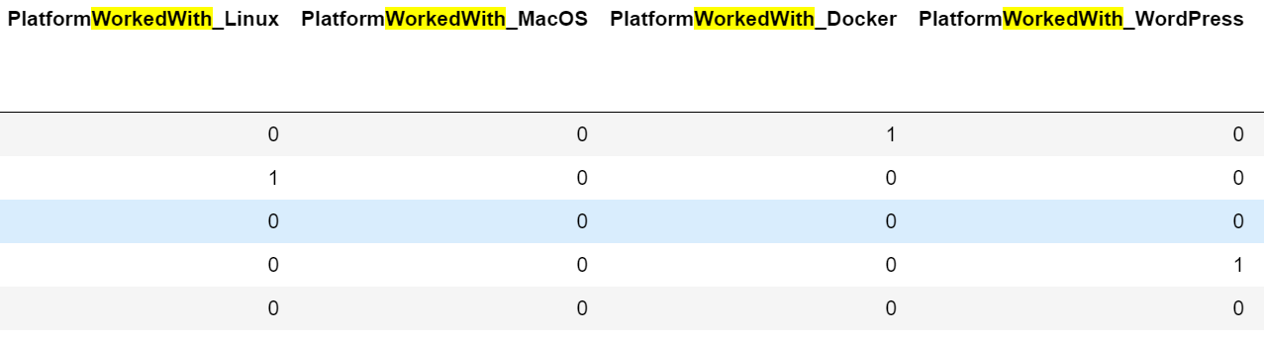
Aggregations : DesireNextYear WorkedWith
Features
How many of the possible options are chosen by developer?
WorkedWith
LanguageWorkedWith
PlatformDesireNextYear
WebframeDesireNextYear
DatabaseDesireNextYear
DesireNextYear
LanguageDesireNextYear
PlatformDesireNextYear
WebframeDesireNextYear
DatabaseDesireNextYear

Slide 15
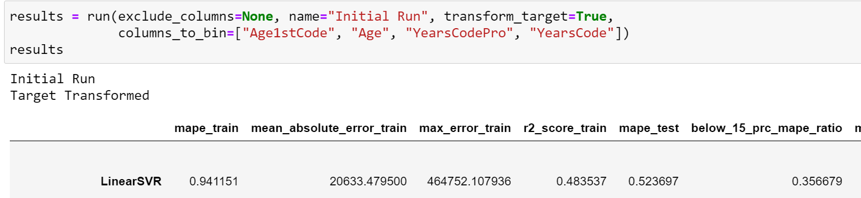
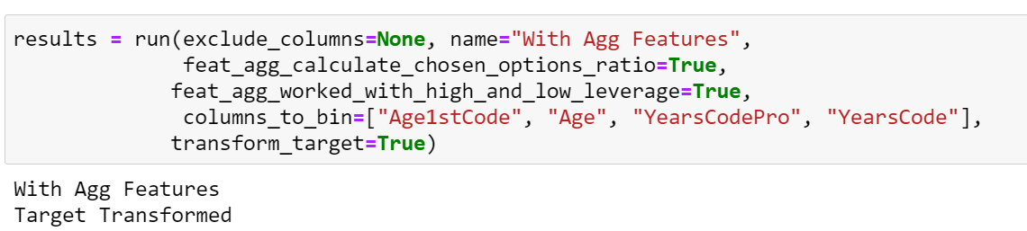
Model
Data transformed with StandardScaler
Defined metrics to evaluate model performance.
Mean Absolute Percentage Error (mape),
Mean absolute error etc.
run_models function
Necessary models implemented
Feature elimination conducted
Return our index value prediction to original absolute value
RidgeCV
LassoCV
LinearSVR
LinearSVR (C=0.1)
LinearSVR (C=10)
SVR (Kernel = ‘rbf’)
DecisionTree
RandomForest

Slide 16
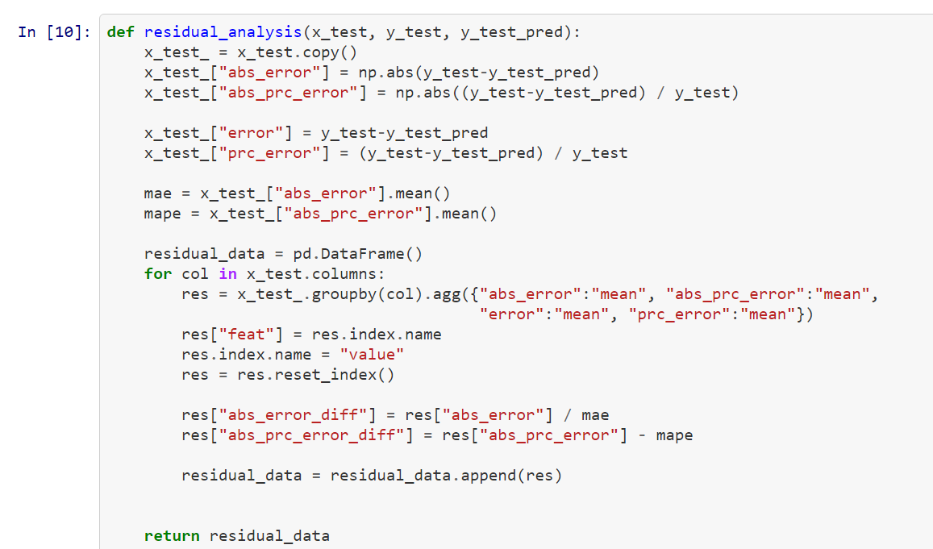
Residual Analysis
To understand which features increase the error rate of model
According to this analysis some of the misleading feature are dropped.
Residuals calculated for each value of each feature.
Mean Abs. Error
Mean Abs. Percent Error
Mean Error
Mean Percent Error

Slide 17
incorrect information in this survey.

Slide 18
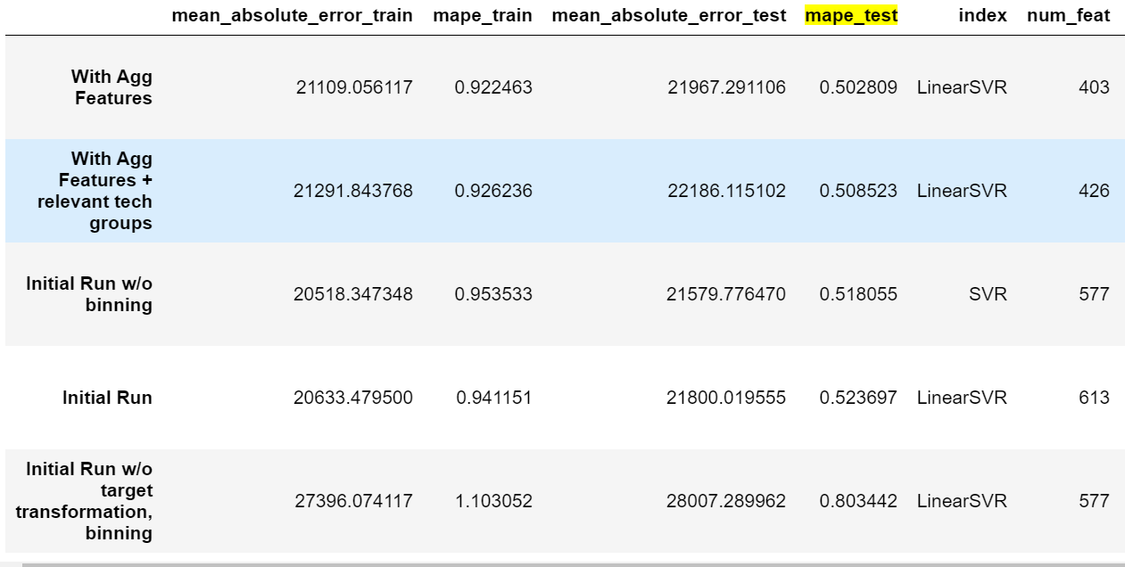
Overall performance of models
Performs best (mape perspective)
Feature aggregation, Target Transformation & Binning
LinearSVR (c = 0,1)
35%
MAPE improvement with
Target transformation
& Binning
4%
MAPE improvement with
Feature Aggregation
*Number of feat decreased by 210
Notes:
columns_to_bin=["Age1stCode", "Age", "YearsCodePro", "YearsCode"]

Slide 19
It fits successfully until outlier values.
Under $200K, model predicts accurately.
Predicted
Actual

Slide 20
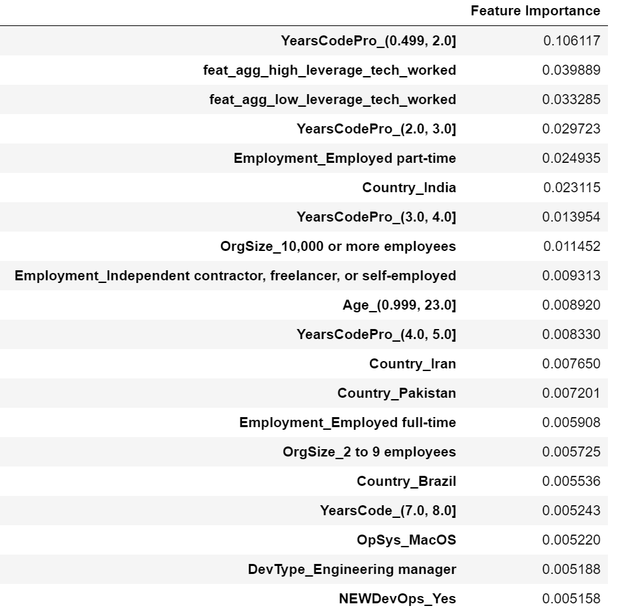
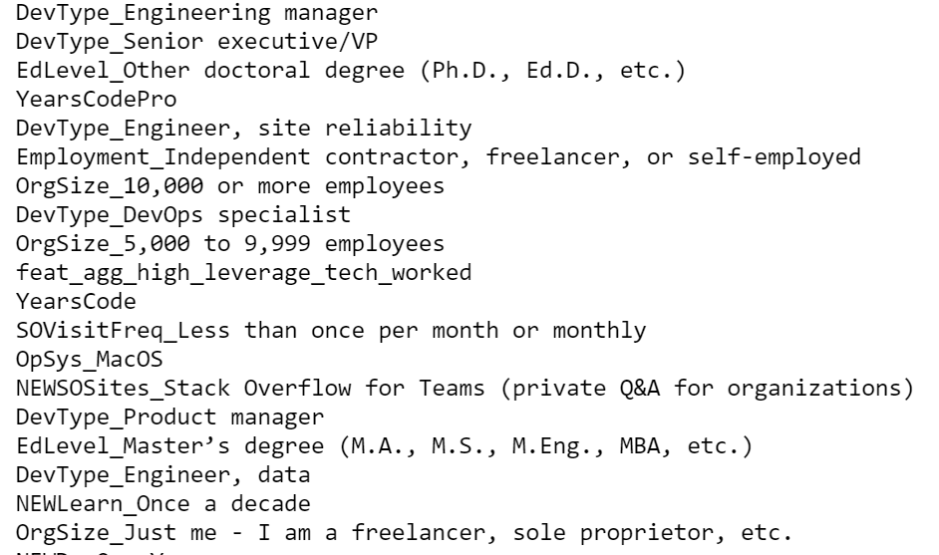
What does effect target attribute most?
What makes this difference?

Slide 21
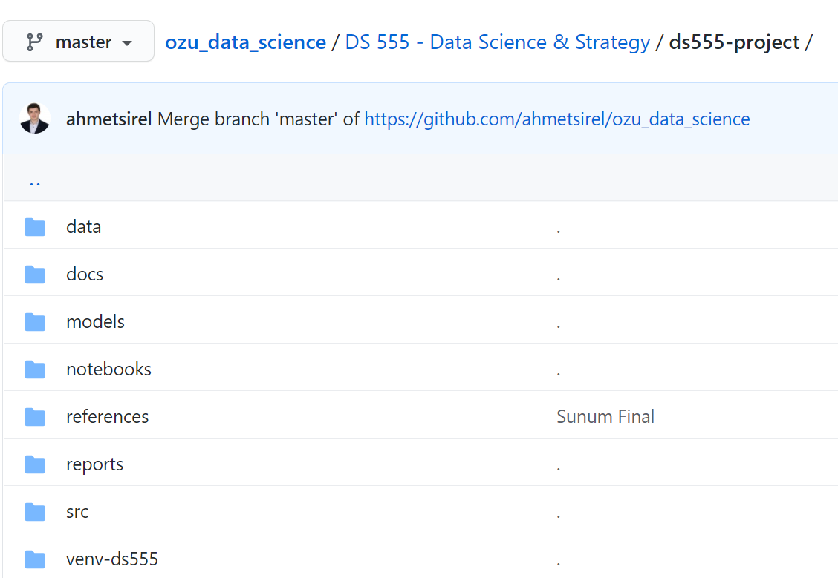
Take a look into our code!
https://github.com/ahmetsirel/ozu_data_science

Slide 22
Thank you for listening
?

